Slide 1
Predicting Debt Collection Success: Using Machine Learning
Analysing Statute-Barred Accounts
Shaurya Chauhan

Slide 2
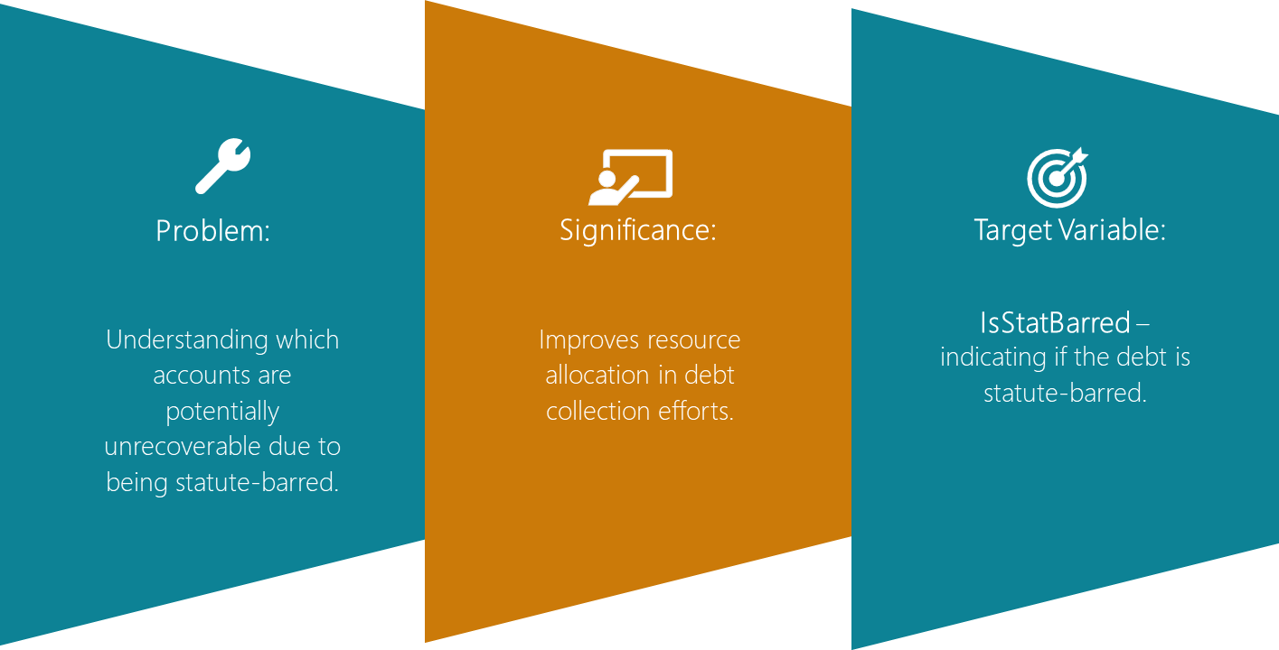
Project analysis slide 2
Introduction to Debt Collection
Context : Effective debt collection is crucial for financial institutions to maintain a healthy balance sheet and cash flow. One key aspect of debt collection that requires careful consideration is identifying accounts that are statute-barred, as this can significantly impact the recoverability of the debt. Statute-barred accounts refer to debts that have passed the legal time limit for debt collection.
Focus: Identifying accounts that are statute-barred, impacting recoverability. Such accounts could be predicted through various factors, such as the age of the debt, payment history, and customer demographics, to identify accounts that are more likely to be recovered before they become statute-barred.
Objective :To address this challenge, developing a machine learning model to predict successful debt recovery could be a valuable approach.

Slide 3
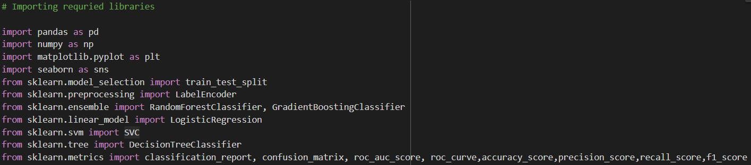


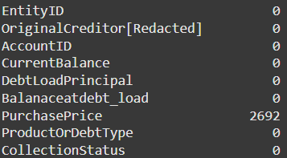
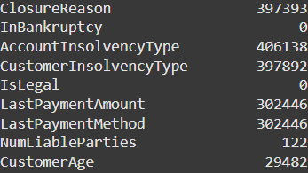
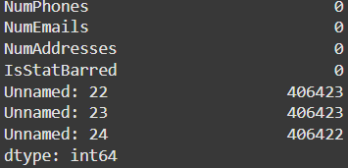
Project analysis slide 4
Data Preprocessing
1. Loading Libraries:
2. Loading the Dataset:
3. Identifying Missing Values:

Slide 4
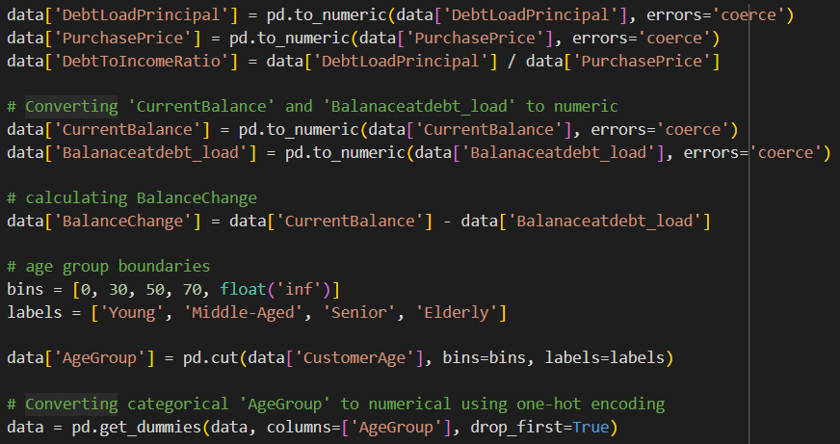
Project analysis slide 4
Feature engineering
4. Creating new features:
Here, two new features are calculated:
'Debt To Income Ratio': Created by dividing 'Debt Load Principal' by 'Purchase Price'. This represents the ratio of debt to purchase price.
'Balance Change': Calculated by subtracting ‘Balance at debt load' from 'Current Balance'. This represents the change in balance.
These new features might provide valuable insights for the machine learning model.
We are creating a new categorical feature called ’Age Group' based on the 'Customer Age' column.
Each bin is assigned a label from the labels list ('Young', 'Middle-Aged', 'Senior', 'Elderly’). Bins defined for (0-30, 30-50, 50-70, 70 and above).

Slide 5
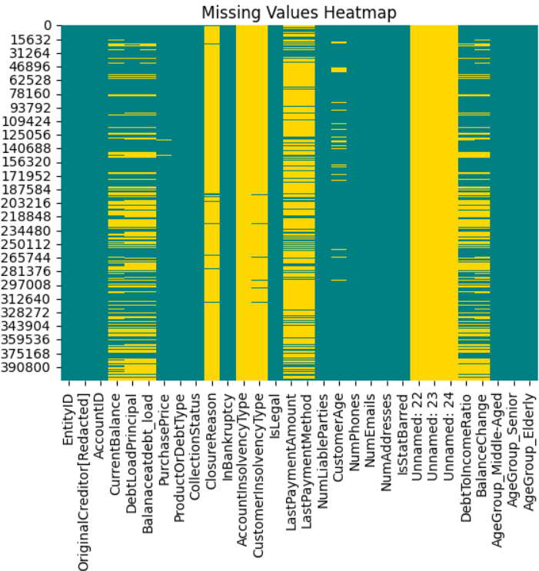
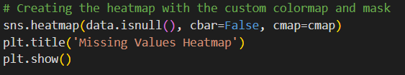
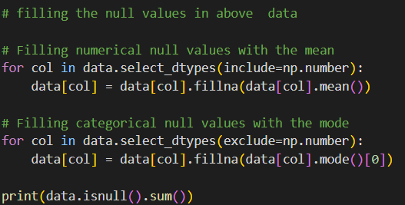
Project analysis slide 5
Handling Missing Data
5. Visualize missing data:
6. Handling Missing Data:

Slide 6
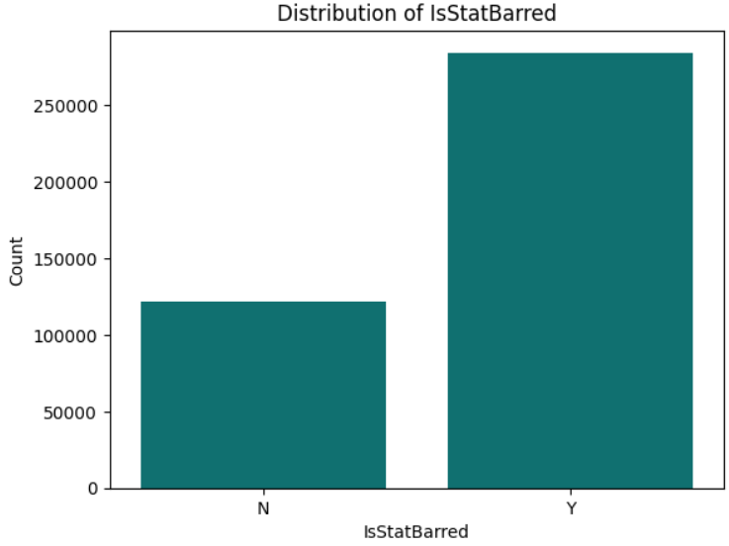
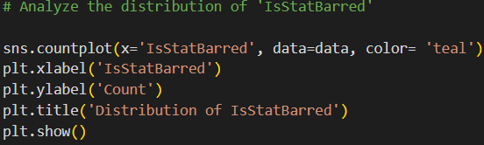
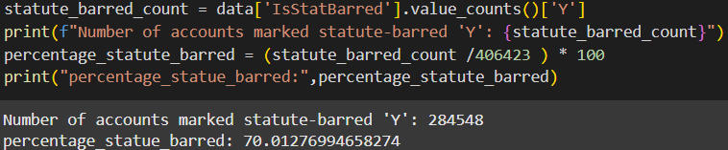
Project analysis slide 6
Exploratory Data Analysis (EDA)
6. Visualizations:
7. Insights:
The count plot here shows us the number of debts that are statute-barred and the number of debt that are not. This is represented by the height of the bars for "Yes" and "No“.
“Y” bar is significantly taller than the “N”, it indicates an imbalanced dataset, meaning there are far more debts in statute-barred compared to the other.
Here , A large imbalance may indicate potential bias to wards status-barred accounts.

Slide 7
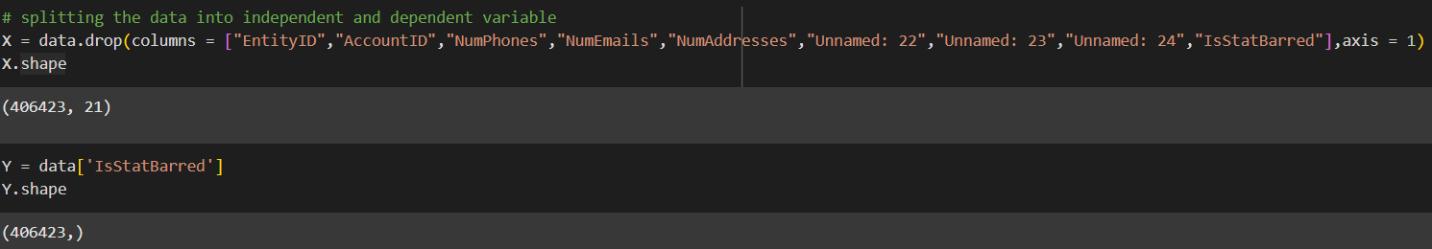

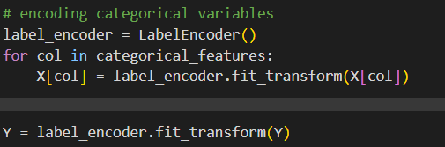
Project analysis slide 8
Feature Selection
1. Splitting the data
Dividing the dataset into two parts:
Independent Variables (Features): These are the factors that might influence or predict the outcome we're interested in. They are stored in the variable X.
Dependent Variable (Target): This is the outcome we're trying to predict.
We are performing the step early to remove the unnecessary variables.
2. Data Type Identification
Label Encoding
1. Applying Label Encoder
Converting categorical data (text or labels) into numerical representations.

Slide 8
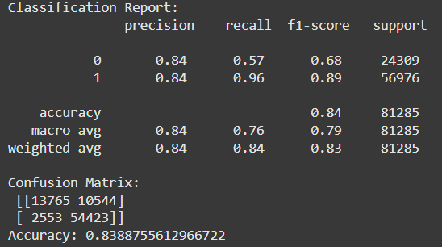
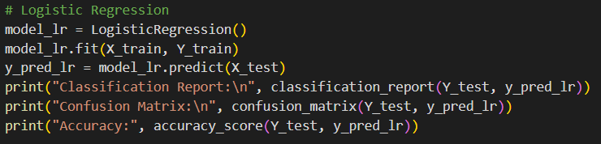
Project analysis slide 7
Splitting the Dataset
1. Data Splitting
Dividing the dataset into:
Training data: Used to train the machine learning model. This is usually the largest portion of your data (e.g., 70-80%,here 80% of data is taken ).
Testing data: Held out and used only to evaluate the performance of the trained model. This simulates how well your model would generalize to unseen data (e.g., 20-30%).
Model Training
1. Logistic Regression

Slide 9
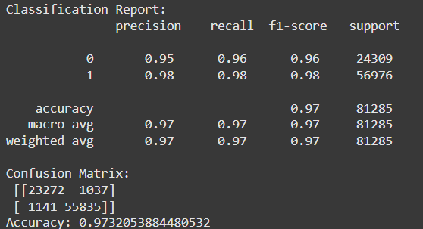
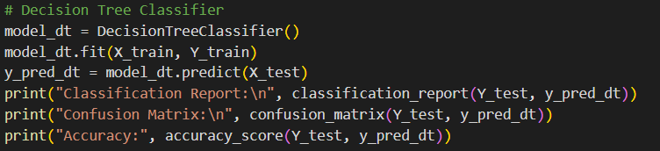
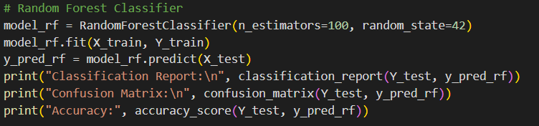
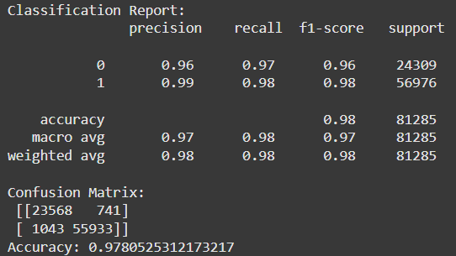
Project analysis slide 10
Model Training
2. Decision Tree Classifier
3. Random Forest Classifier

Slide 10
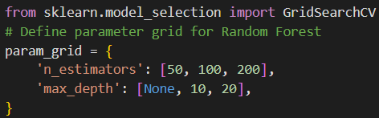
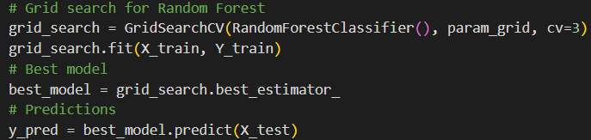

Comparative Analysis
Performance Overview
Accuracy : Random Forest exhibited the highest accuracy (0.978), followed by Decision Tree (0.973) and then Logistic Regression (0.838).
Precision and Recall : The Random Forest model performed best in both precision and recall metrics, suggesting it is more reliable in classifying both positive and negative instances accurately .
We know that, Decision Trees can model complex patterns but are prone to overfitting, particularly with limited training data sizes. Hence, we move ahead with Random Forest Classifier.
Hyperparameter tuning
1. Finding the best combination for the model
To improve the accuracy and reliability of the model’s predictions we take:
n_estimators: This hyperparameter controls the number of decision trees in the Random Forest. The code will test using 50, 100, and 200 trees.
max_depth: This hyperparameter limits the depth (or how many levels of decisions) each decision tree can have. The code will try not limiting the depth (None), limiting to 10 levels, and limiting to 20 levels.

Slide 11
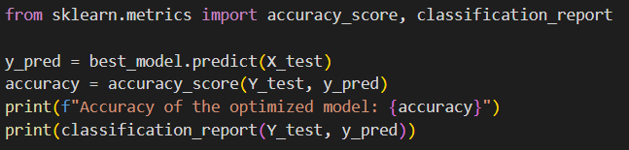
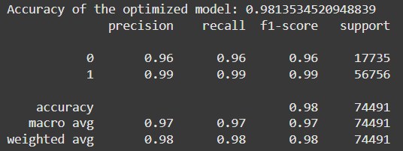
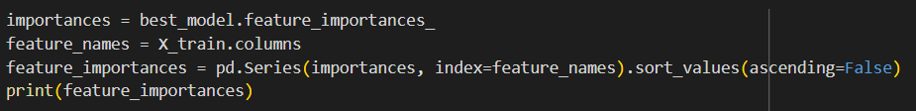
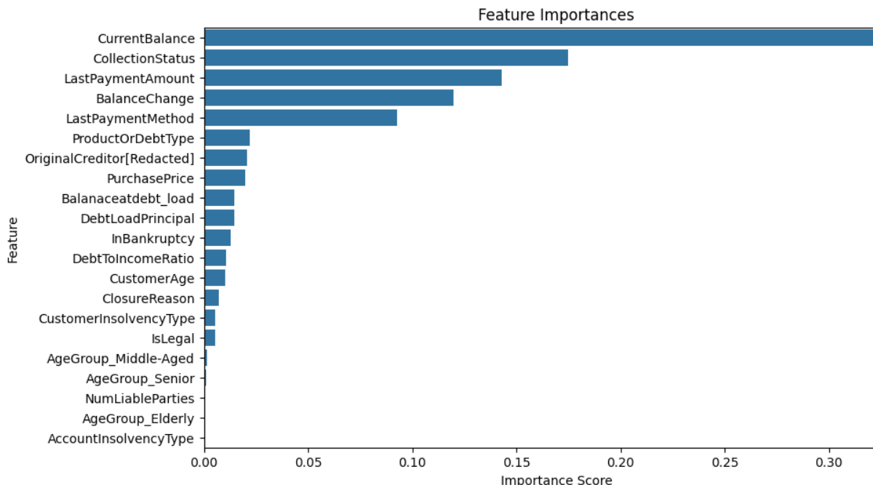
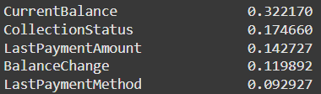
2. Retraining the model with optimal hyperparameters.
After performing tunning, the precision has improved to 0.96 from 0.95 and accuracy of the model has increased to 0.981 from 0.979.
Feature Importance
1. Finding important features affecting Data
Top five variables effecting data:

Slide 12
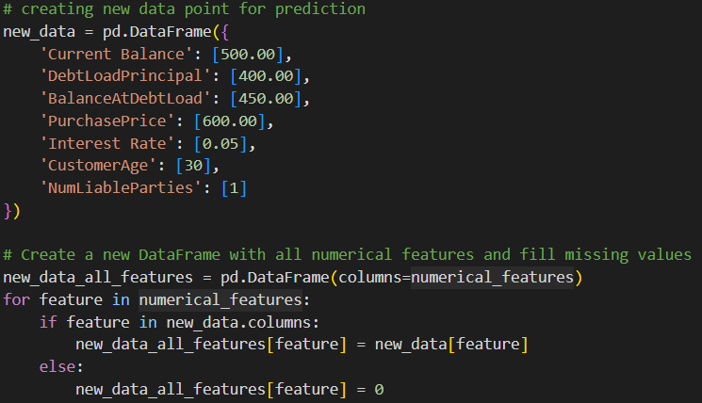
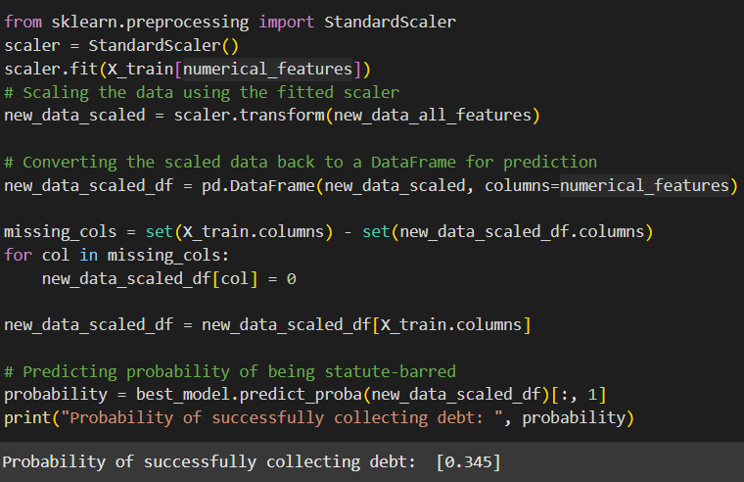
Testing Unseen Data
Taking a new, unseen data point (representing a customer) and predicting the probability of the customer's debt being collectible or not. Further, it displays the probability of the debt being successfully collected.

Slide 13
Thank You

Slide 14
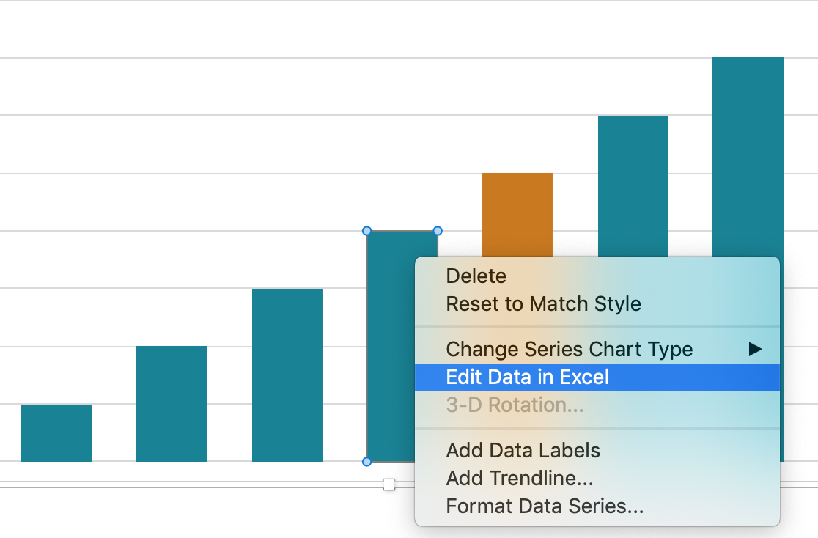
Project analysis slide 11
Editing Data
Slides
If you would like to modify the data in the graphs and chart included in this template, simply right click on the diagram and select Edit Data in Excel.
Excel will then open and you can edit the relevant data.

